Slide 1
Norma Jean and the Aesthetics of HardCore Rock
An argument towards validating
the genre’s historical position
with a critical examination of
the style’s orchestrated dimensions

Slide 2
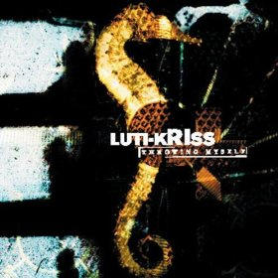
Precedent
1997
Atlanta, Georgia
Christian faith
Other pioneering groups like Botch, Converge and Dillinger Escape Plan occurring within the MetalCore, HardCore Punk and MathCore genres

Slide 3
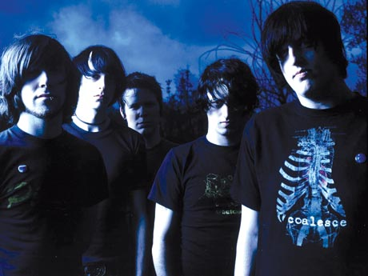
Personnel
2002
Daniel Davison, drums
Christopher Day, guitar
Joshua Doolittle, bass
Scottie Henry, guitar
Josh Scogin, vocals

Slide 4
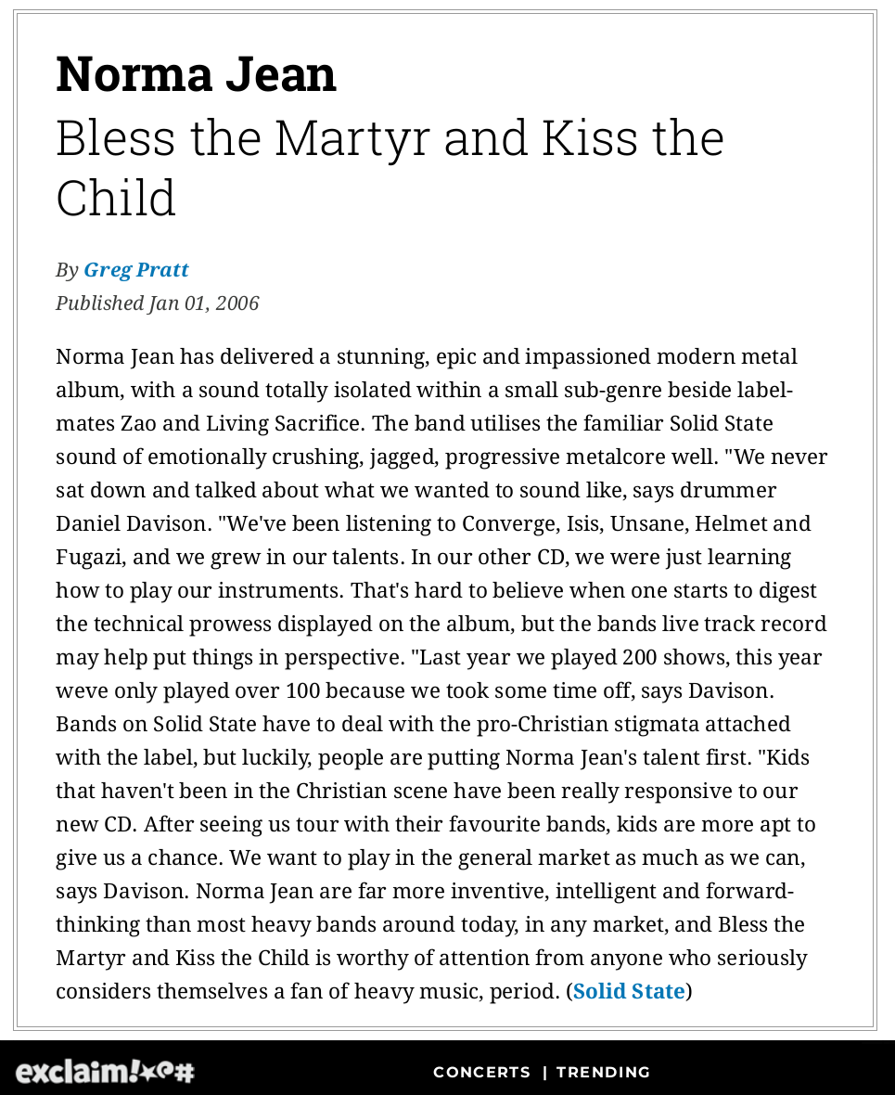
Critique
Bless the Martyr and Kiss the Child
Artistically recognized as a significant contribution to the genre of MetalCore

Slide 5
ANALYSIS
Terminology
V AESTHETICS
IV CONTEXT
III PURPOSE
II LANGUAGE
I DIMENSIONS

Slide 6
Spectrum V
Individual Aesthetics
1 Comprehension  “Understanding, Unawareness”
2 Affectation  “Like/Dislike”
3 Craft  “Good/Bad”
4 Fulfillment  “Success/Failure”

Slide 7
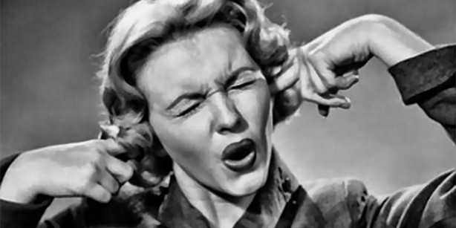
Ideality
Justification of
opinion

Slide 8
Spectrum IV
Historical Context
1 Innovation: Original / Progressive
2 Development: Classic / Tradition / Limit
3 Transformation: Declination / Appropriation / Maturation / Integration
4 Modes of Communication: Composer, Performer, Audience

Slide 9
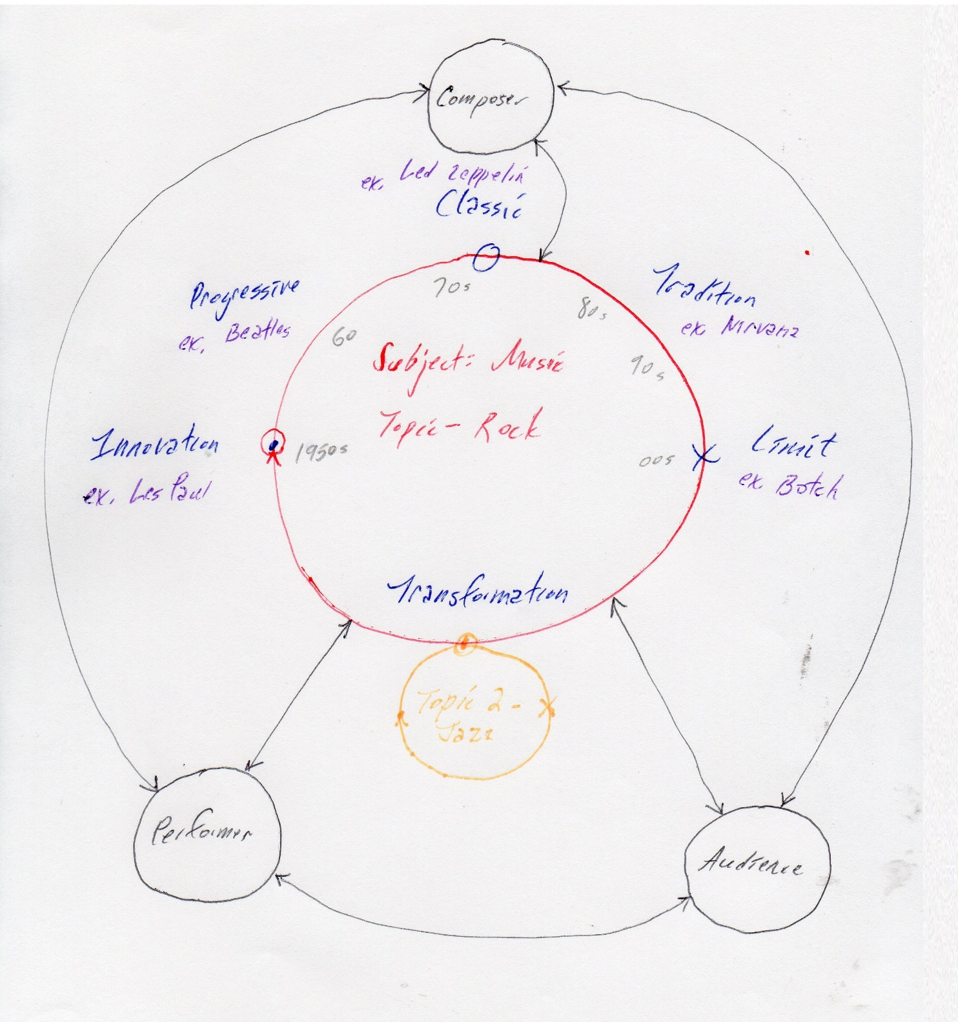
Topic
Rock and Roll
Positioned at Extremity

Slide 10
Spectrum III
Creative Purpose
1 Social Component
2 Emotional Expression
3 Figurative Representation
4 Technical Grammar

Slide 11
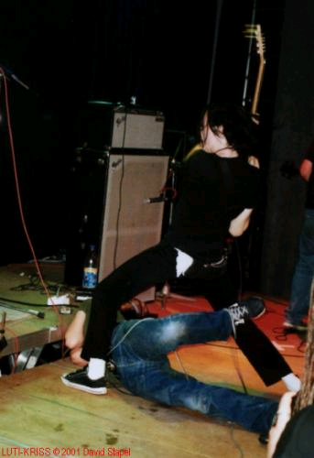
Personal Identification
Intensification of the self

Slide 12
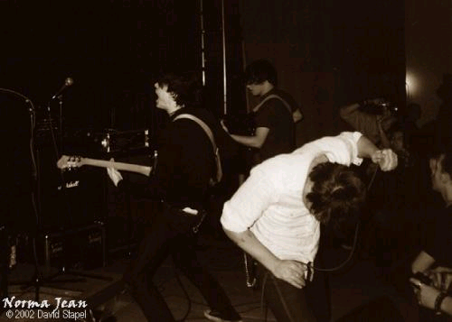
Practical Application
Sustained Intensity

Slide 13
Spectrum II
Stylistic Factors
1 Structural Tonality
2 Accordant Sonority
3 Modular Form
4 Orchestrative Medium

Slide 14
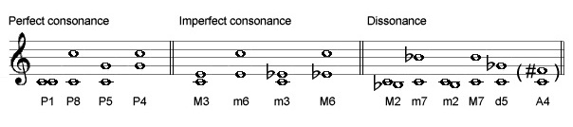
1 Harmony
Diadic (rather than Triadic tradition)

Slide 15

2 Consonance/
Dissonance
Constant tension

Slide 16
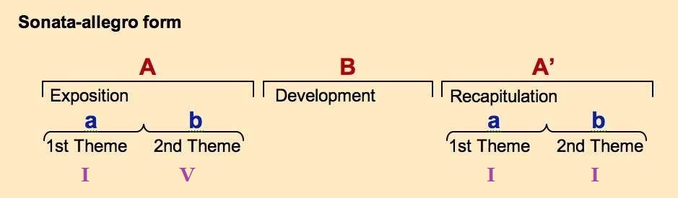
3 Organization
Principle of Expectation, Deviation and Restoration

Slide 17
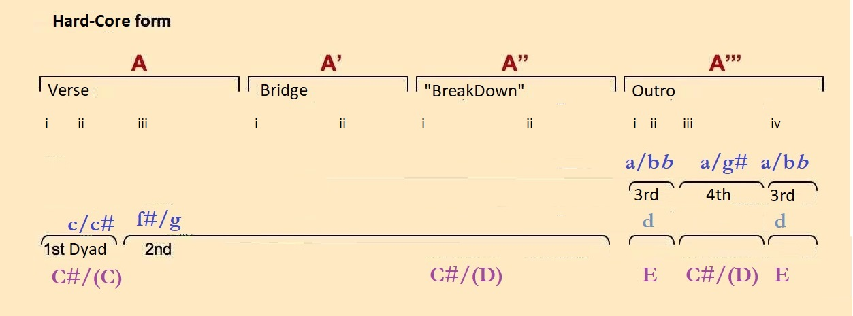
Organization B
Principle of prolonged and compounded Extension

Slide 18
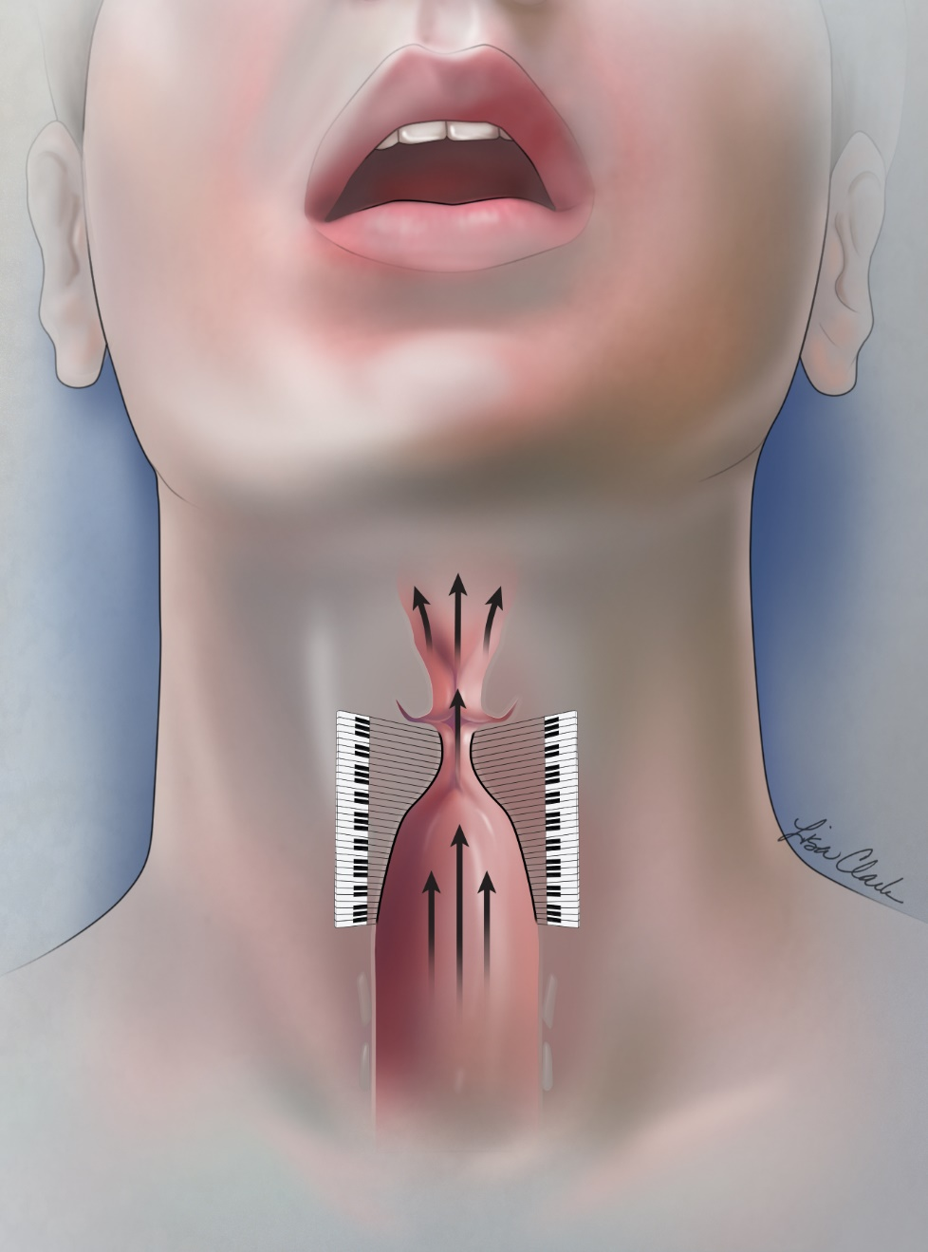
4 Instrumentation
Vocals- persistent scream
Guitars- exotic tuning

Slide 19
Spectrum I
Elemental Dimensions
1 Duration
2 Pitch
3 Volume
4 Surface

Slide 20
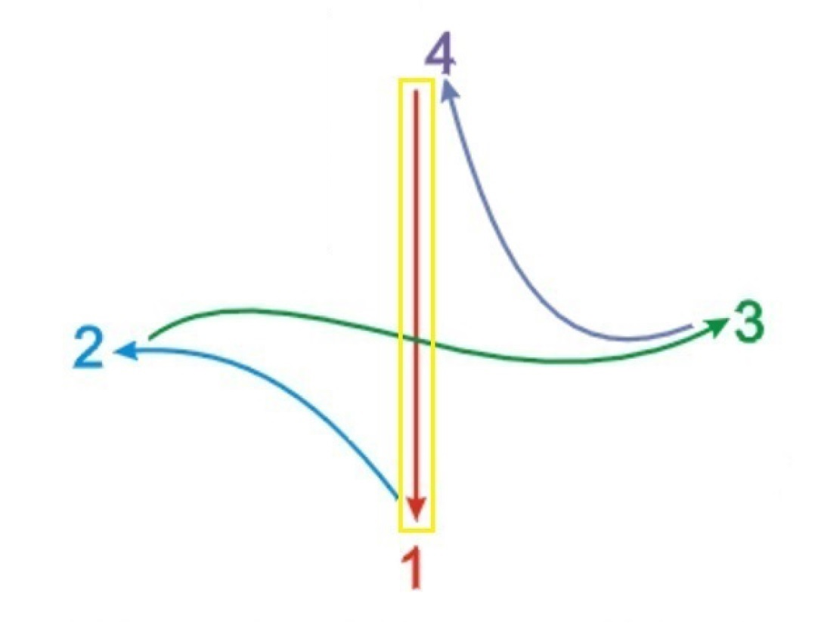
1i Beat
A heavily driving Pulse

Slide 21

1ii Meter
The regular Grouping of beats notably “Breaks Down” into strict pattern

Slide 22
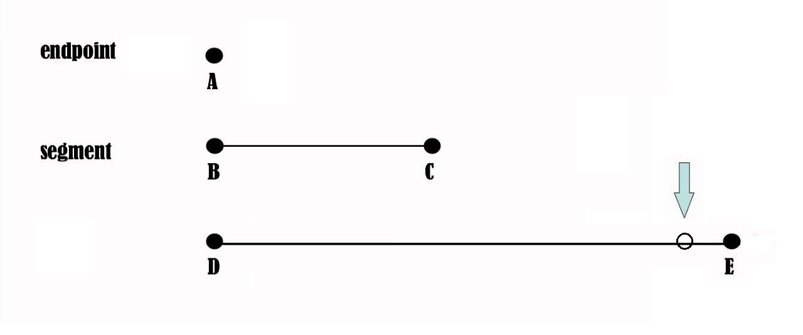
1iii Rhythm
Notes and percussive (ie. snare drum) strikes often are placed over the beat in a “snapping” Pattern, just before the end of a phrase

Slide 23
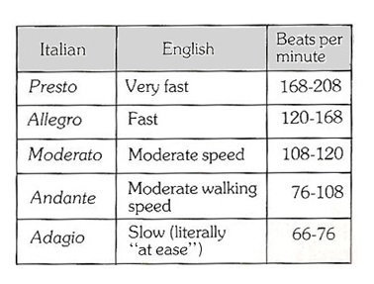
1iv Tempo
The Music often changes suddenly between very Fast and very Slow

Slide 24
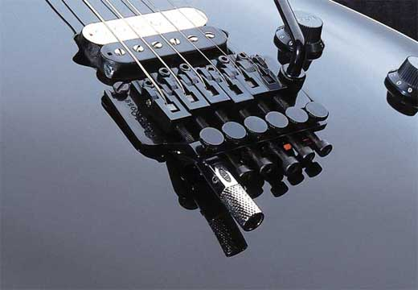
2i Register
Characteristically ‘Dropped’ Tuning

Slide 25
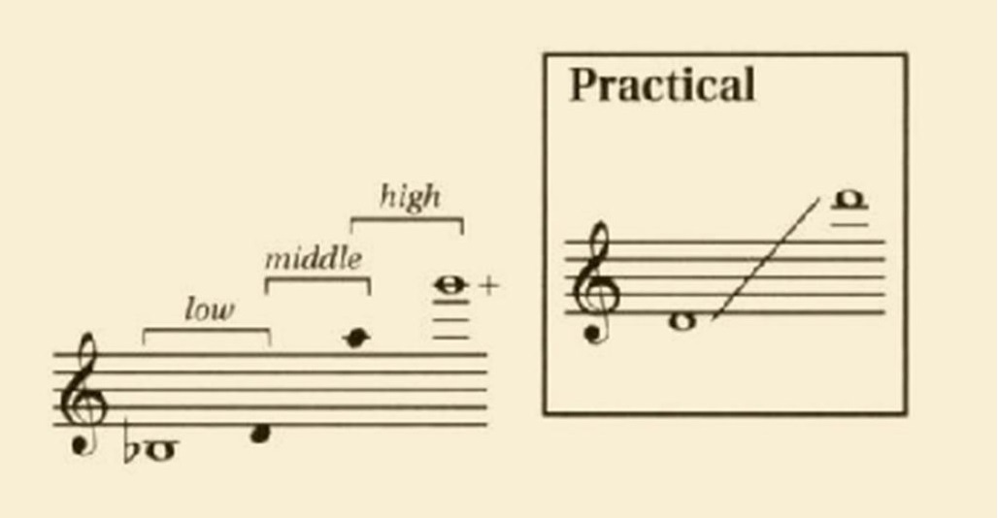
2ii
Compaction
Frequently a Wide
‘polarity’ between
vertical Notes

Slide 26
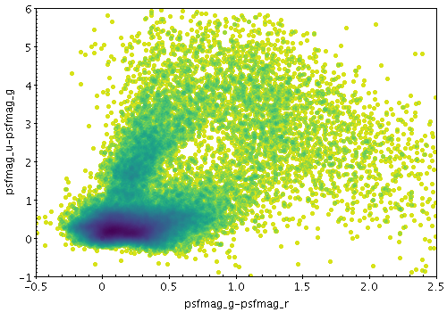
2iii Consistency
Often Thick with orchestrated
Notes

Slide 27
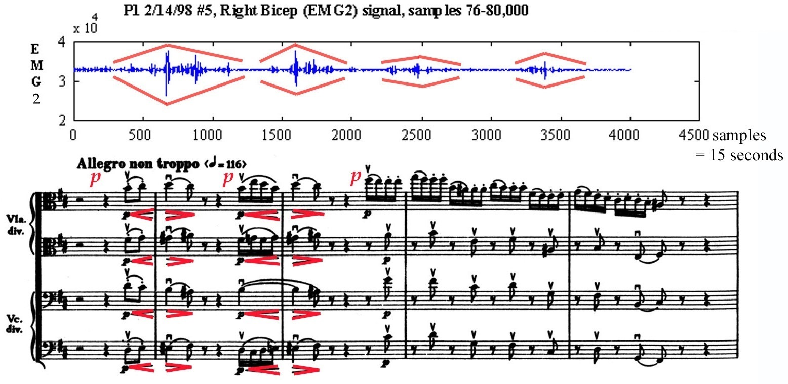
3i Dynamics
Predominantly Loud to the point of content ‘dissolution’

Slide 28

4i Tone
Typically Noisy sound

Slide 29
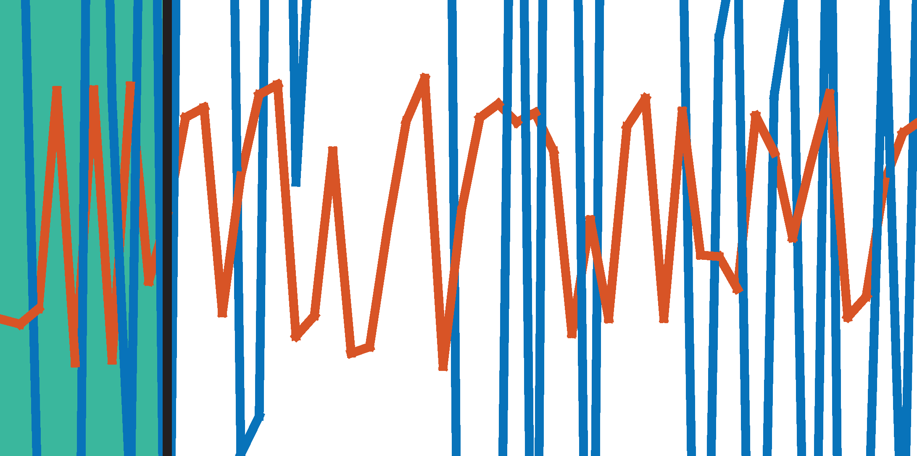
4ii Grain
Commonly ‘Rough’
waveforms

Slide 30
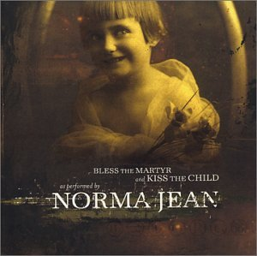
Sample
“The Entire World Is Counting On Me and They Don’t Even Know It”
https://www.youtube.com/watch?v=ysH8EweWQhQ

Slide 31
Conclusion
Given maximum and minimum artistic positions, a short epoch occurred between Innovators and Classic figures of the MetalCore genre [late 1990s-early 2000s]
Given maximum and minimum artistic positions also, MetalCore exemplifies the historic fulfillment of Rock and Roll as a broader style
Alongside exuberant entertainment though, the music arguably has authentic value when achieving a cathartic function

Slide 32
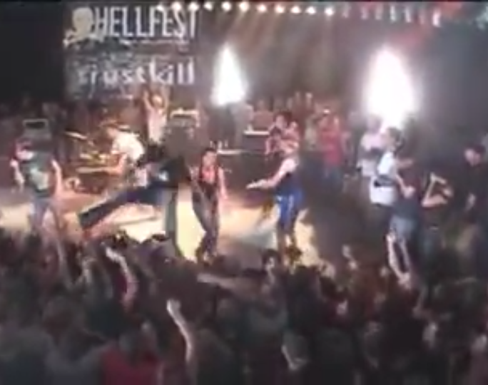
Live performance
Hellfest, 2003
https://www.youtube.com/watch?v=3KUfPw4diNU

Slide 33
Bibliography
Meter
https://www.publicdomainpictures.net/en/view-image.php?image=129529
Rhythm
https://youtube.com/watch?v=7TJF8_kvJWI
Consistency
http://www.star.bris.ac.uk/~mbt/topcat/sun253/mode-density.html
Compaction
https://slideplayer.com/slide/7405941
Tone
https://www.freepik.com/free-vector/noise-background_992066.htm
Noise
https://stackoverflow.com/questions/29903531/matlab-graphics-jagged-lines-in-output
Form
https://gointothestory.blcklst.com/sonata-form-and-three-act-structure-e6a0c7f3a49e
http://kivan.yellowriverwebsites.com/what-is-sonata-form
Medium
https://phys.org/news/2016-06-pitch-range-vocal-cords.html

